Slide 1
Science Writing and the Mainstream Media
Will Ferguson
Mentor: Tom Beal, Arizona Daily Star science writer
21st annual Arizona Space Grant Consortium Symposium-Arizona State University, Phoenix, Arizona, April 21, 2012

Slide 2
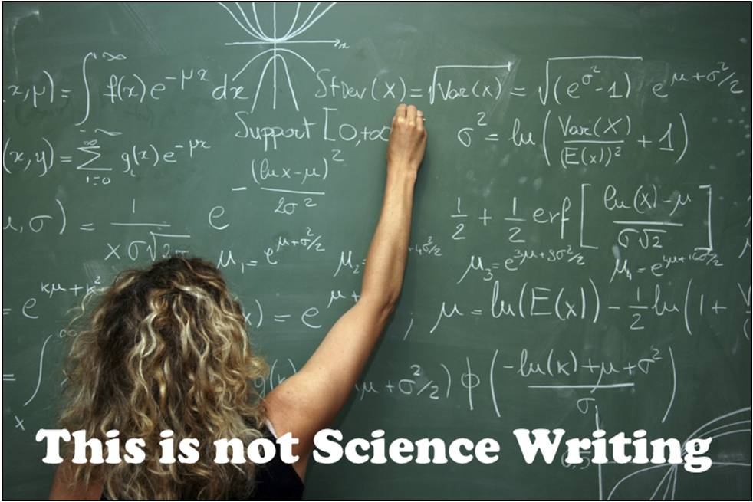
Outline
Finding quality research
How to make people care-discovering the practical applications.
Intuitive, informative, accurate
How effective is the mainstream media?

Slide 3
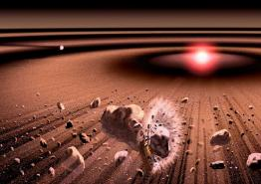
How to find good science
Swirling around a central star, those accumulations of dust and debris provide the raw materials for nascent planets and witness collisions among asteroids Credit: UANEWS/JAXA)

Slide 4

Natural characteristics of the area
University news service
Technology transfer
Talk to researchers

Slide 5
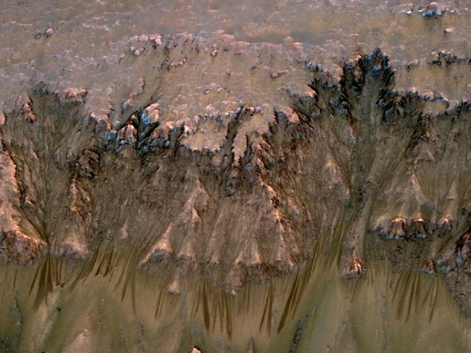
Example: HiRISE camera finds signs of water on Mars
Dark, finger-like patterns on martian slopes imaged by the UA controlled HiRISE camera. Credit: NASA

Slide 6
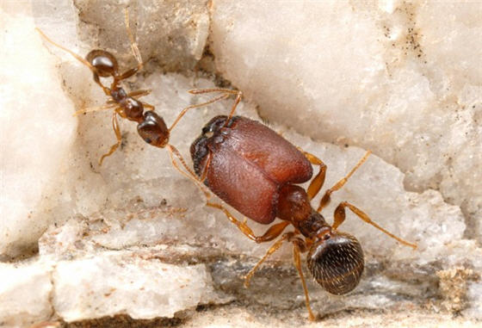
Interesting aspects of complicated research
Researchers at McGill University have grown supersoldier ants in different species of pheidole ants. The oversized ants have enormous heads and jaws compared to a regular sized ant. Credit: Alex Wild

Slide 7
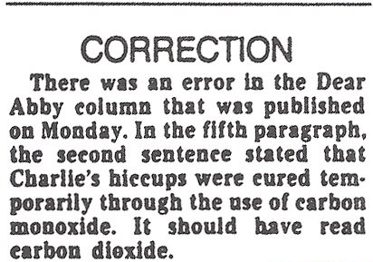
Intuitive yet ACCURATE

Slide 8
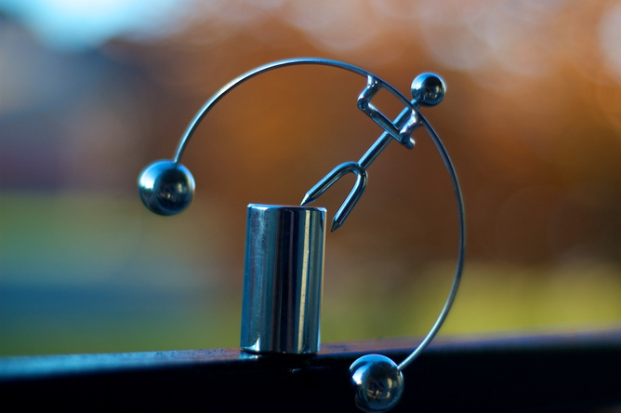
Results of a delicate balancing act

